Slide 1
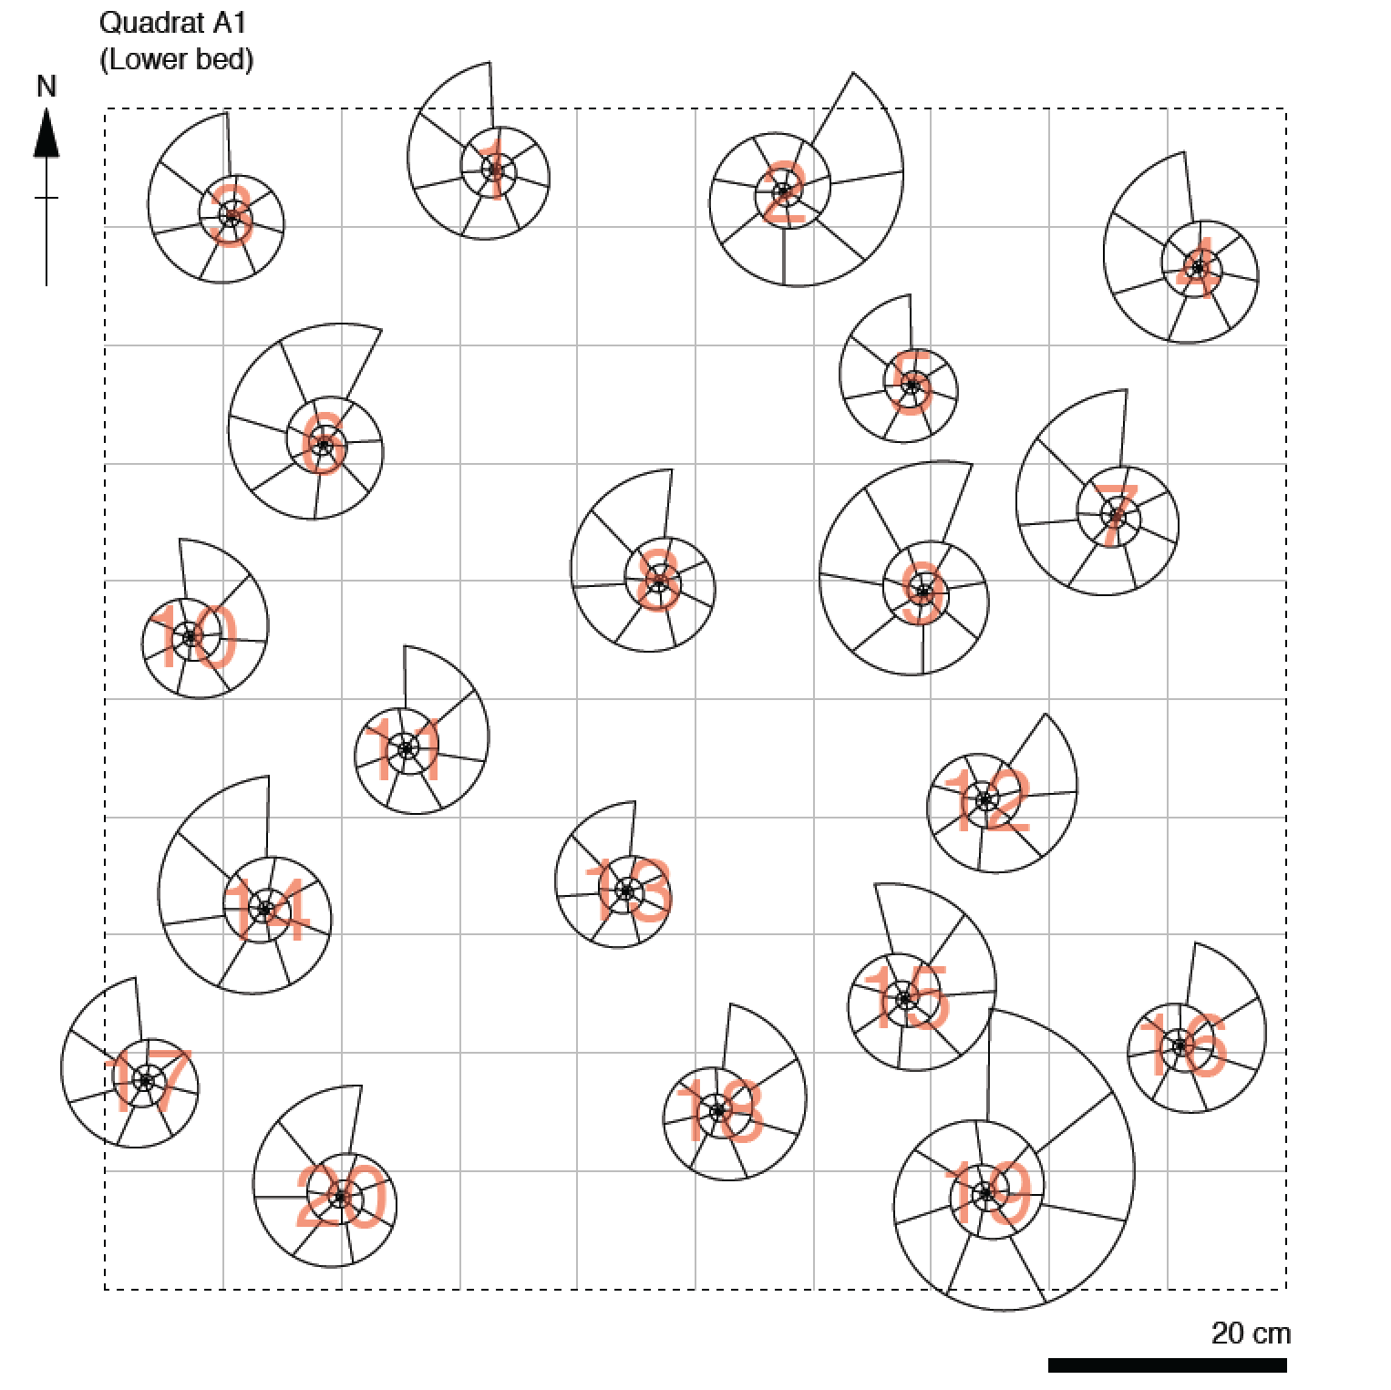
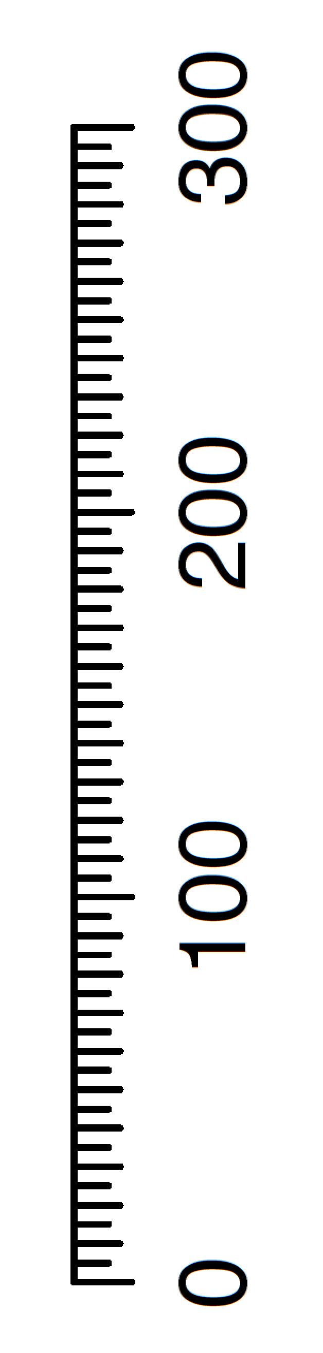
For today’s lecture you will need:
x 1
x 1

Slide 2
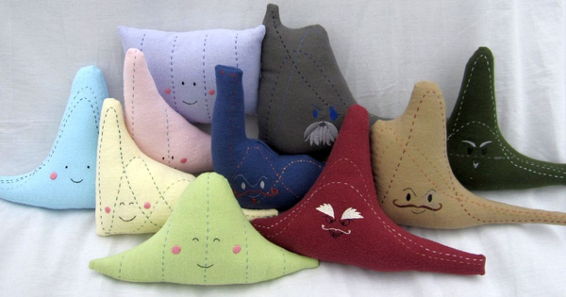
SOEE1475 Statistics and Data Analysis
Lecture 2: Univariate statistics
Graeme T. Lloyd

Slide 3

Today
Defining statistical terms
Introduce ammonite quadrat data set
First statistical test (the t-test)
Notes:
Today’s topics.

Slide 4
Variable variables

Slide 5
Variable variables
Variable (computing)
Data storage; can change over as time as program executes

Slide 6
Variable variables
Variable (computing)
Data storage; can change over as time as program executes
Variable (statistics)
Any characteristic, number, or quantity that can be measured or counted

Slide 7
Variable types
Univariate
A single type of measurement

Slide 8
Variable types
Univariate
A single type of measurement
Bivariate
Two types of measurement

Slide 9
Variable types
Univariate
A single type of measurement
Bivariate
Two types of measurement
Multivariate
Three or more types of measurement

Slide 10
Data types
Discrete
Only integer values (e.g., counts)

Slide 11
Data types
Discrete
Only integer values (e.g., counts)
Continuous
Decimals/fractions possible

Slide 12
Data types
Discrete
Ratio scale
Terminate at zero (e.g., mass, Kelvin)
Only integer values (e.g., counts)
Continuous
Decimals/fractions possible

Slide 13
Data types
Discrete
Ratio scale
Terminate at zero (e.g., mass, Kelvin)
Only integer values (e.g., counts)
Interval scale
Do not terminate at zero (e.g., Celsius)
Continuous
Decimals/fractions possible

Slide 14
Data types
Discrete
Ratio scale
Terminate at zero (e.g., mass, Kelvin)
Only integer values (e.g., counts)
Interval scale
Do not terminate at zero (e.g., Celsius)
Continuous
Closed scale
Decimals/fractions possible
Fixed terminals at both ends (e.g., %ages)

Slide 15
Data types
Discrete
Ratio scale
Terminate at zero (e.g., mass, Kelvin)
Only integer values (e.g., counts)
Interval scale
Do not terminate at zero (e.g., Celsius)
Continuous
Closed scale
Decimals/fractions possible
Fixed terminals at both ends (e.g., %ages)
Directional
Modular (e.g., compass bearings)

Slide 16
Data types
Discrete
Ratio scale
Terminate at zero (e.g., mass, Kelvin)
Only integer values (e.g., counts)
Interval scale
Do not terminate at zero (e.g., Celsius)
Continuous
Closed scale
Decimals/fractions possible
Fixed terminals at both ends (e.g., %ages)
Directional
Modular (e.g., compass bearings)
Ordinal scale
Data only have rank order (e.g., Moh’s)

Slide 17
Data types
Discrete
Only integer values (e.g., counts)
Continuous
Decimals/fractions possible
Nominal/Categorical
Names (e.g., Limestone, Basalt)

Slide 18
Example: class heights
Univariate
Bivariate
Multivariate
Notes:
Ask class what their heights as data represent

Slide 19
Example: class heights
Univariate

Slide 20
Example: class heights
Univariate
Discrete
Continuous
Nominal/Categorical

Slide 21
Example: class heights
Univariate
Continuous

Slide 22
Example: class heights
Univariate
Continuous
Ratio scale
Interval scale
Closed scale
Directional
Ordinal scale

Slide 23
Example: class heights
Univariate
Continuous
Ratio scale

Slide 24
Populations vs samples

Slide 25
Populations vs samples
Population
All possible values (may no longer exist, or be accessible)

Slide 26
Populations vs samples
Population
All possible values (may no longer exist, or be accessible)
Sample
A subset of the above and the data we actually have

Slide 27
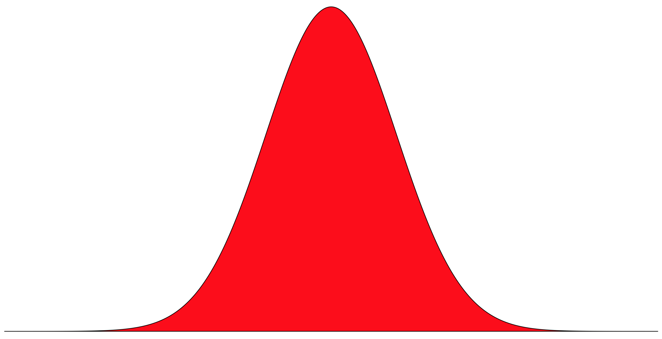
Populations vs samples
Population
(e.g., all humans ever)

Slide 28
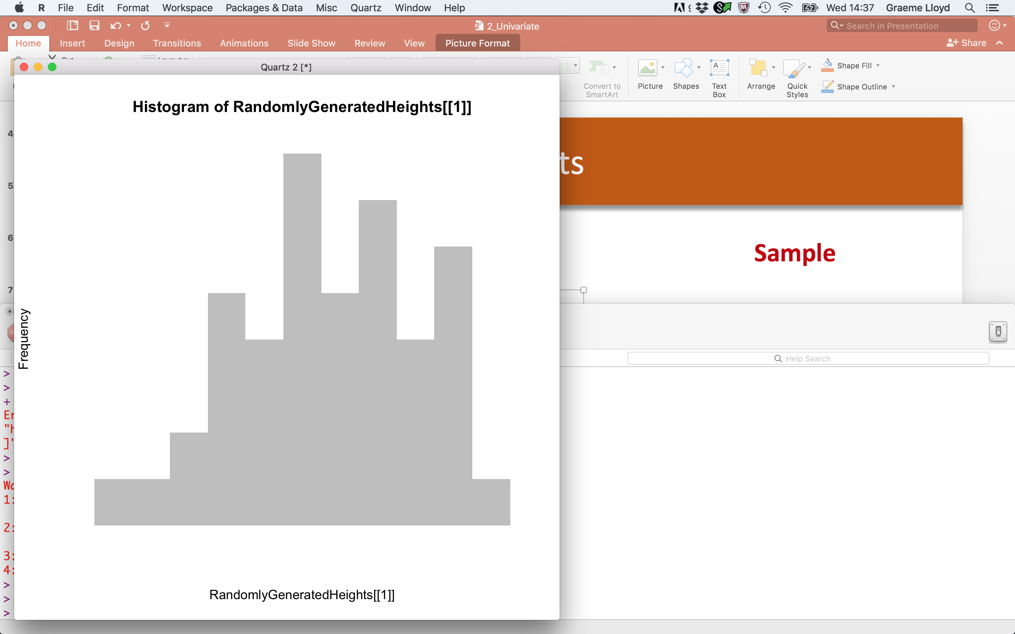
Populations vs samples
Population
Sample
(e.g., all humans ever)
(e.g., the people in this room)

Slide 29
Summarising univariate data

Slide 30
Summarising univariate data
Location
(captures “centre” of distribution)

Slide 31
Summarising univariate data
Location
Dispersion
(captures “centre” of distribution)
(captures “spread” of distribution)

Slide 32
Summarising univariate data
Location

Slide 33
Summarising univariate data
Location
Mean
Sum of values / N values

Slide 34

Summarising univariate data
Location
Mean
mean(x = ClassHeights)
68.02273
Sum of values / N values

Slide 35
Summarising univariate data
Location
Mean
mean(x = ClassHeights)
68.02273
Sum of values / N values
Median
Middle value

Slide 36
Summarising univariate data
Location
Mean
mean(x = ClassHeights)
68.02273
Sum of values / N values
Median
median(x = ClassHeights)
68.25
Middle value

Slide 37
Summarising univariate data
Location
Mean
mean(x = ClassHeights)
68.02273
Sum of values / N values
Median
median(x = ClassHeights)
68.25
Middle value
Mode
Most frequently occurring value(s)

Slide 38
Summarising univariate data
Location
Mean
mean(x = ClassHeights)
68.02273
Sum of values / N values
Median
median(x = ClassHeights)
68.25
Middle value
Mode
# See below!
69
Most frequently occurring value(s)
rle(sort(ClassHeights))$values[which(rle(sort(ClassHeights))$lengths == max(rle(sort(ClassHeights))$lengths))]

Slide 39
Summarising univariate data
Dispersion

Slide 40
Summarising univariate data
Dispersion
Variance
Mean squared distance from mean

Slide 41
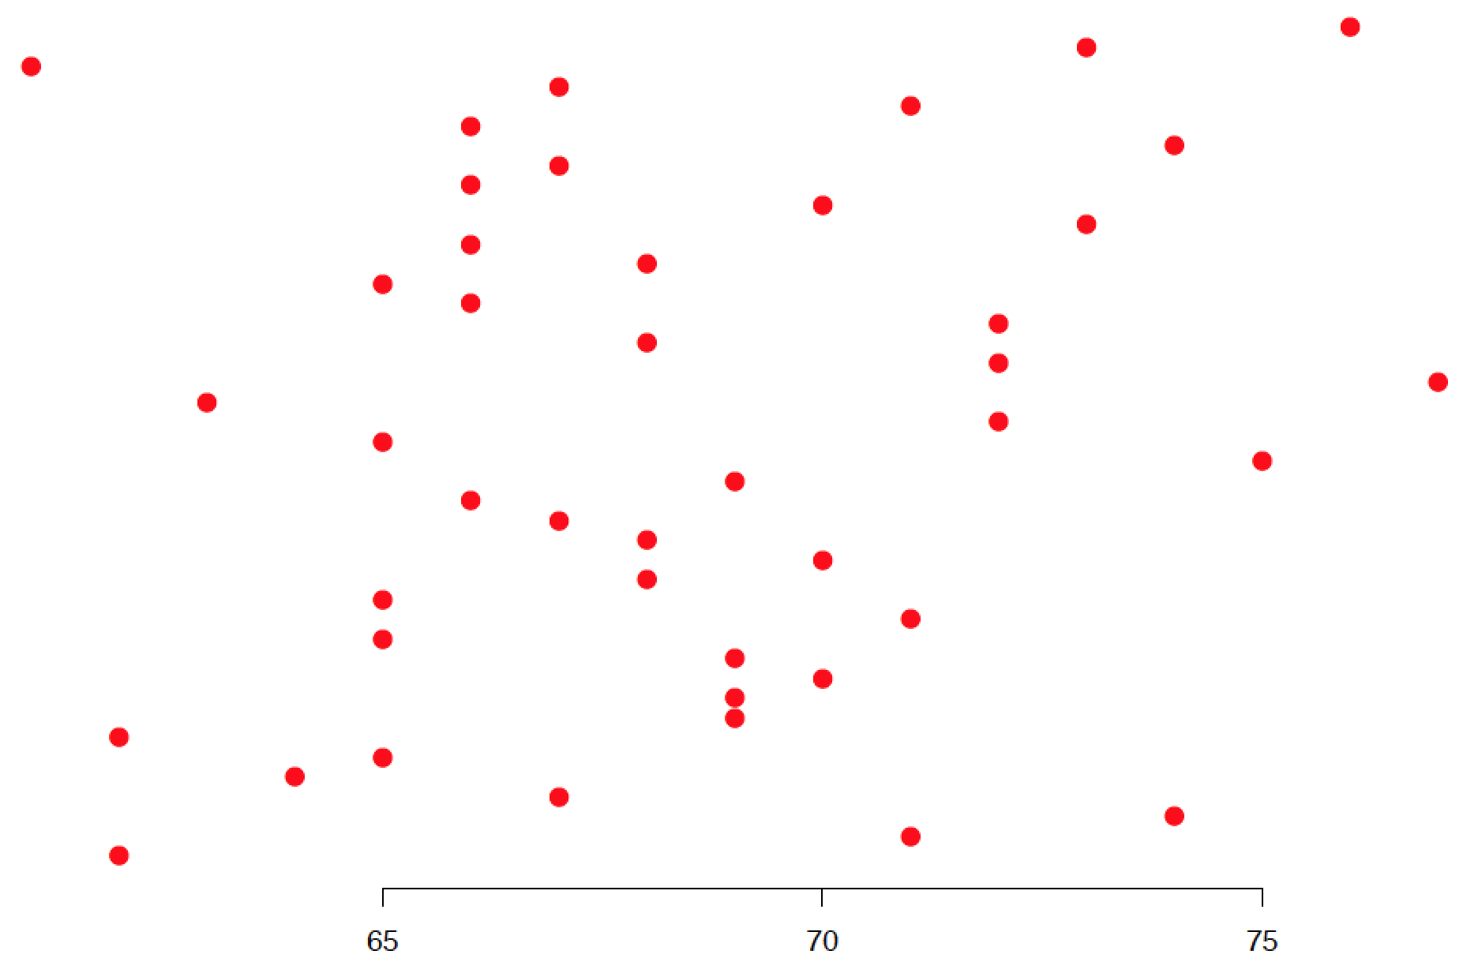
Summarising univariate data
Dispersion
Variance
Mean squared distance from mean
Height (Inches)

Slide 42
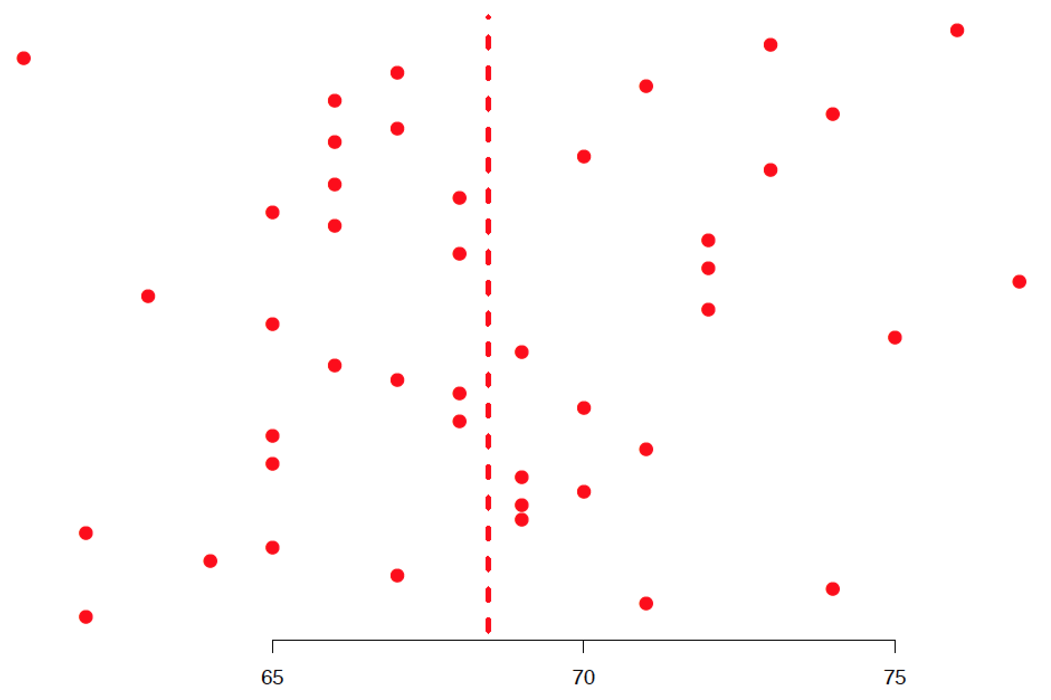
Summarising univariate data
Dispersion
Mean
Variance
Mean squared distance from mean
Height (Inches)

Slide 43
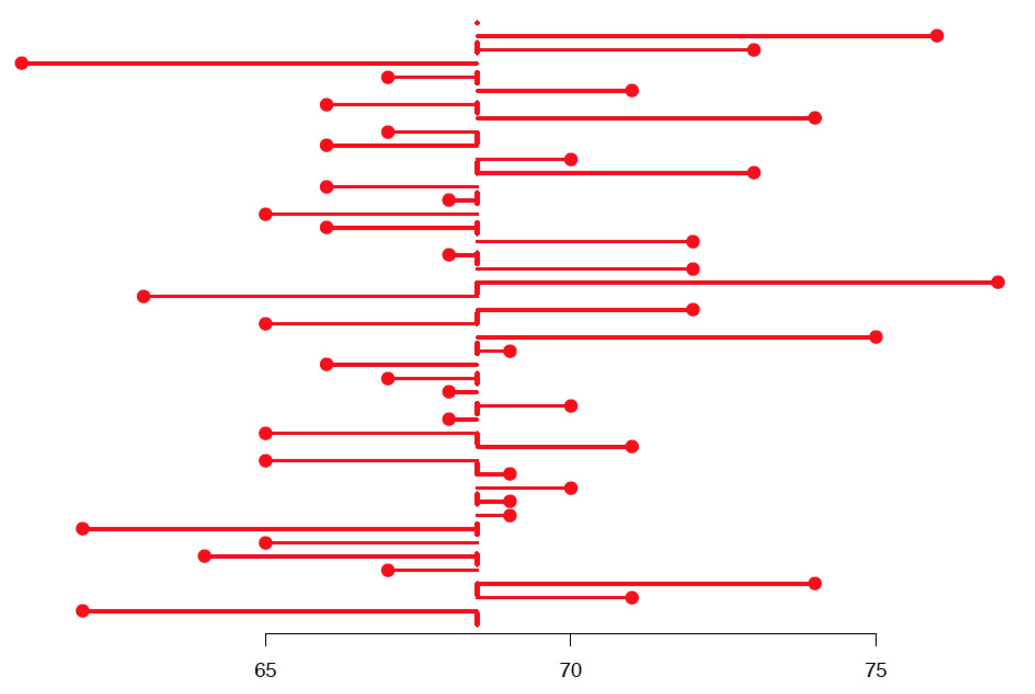
Summarising univariate data
Dispersion
Mean
Variance
Mean squared distance from mean
Height (Inches)

Slide 44
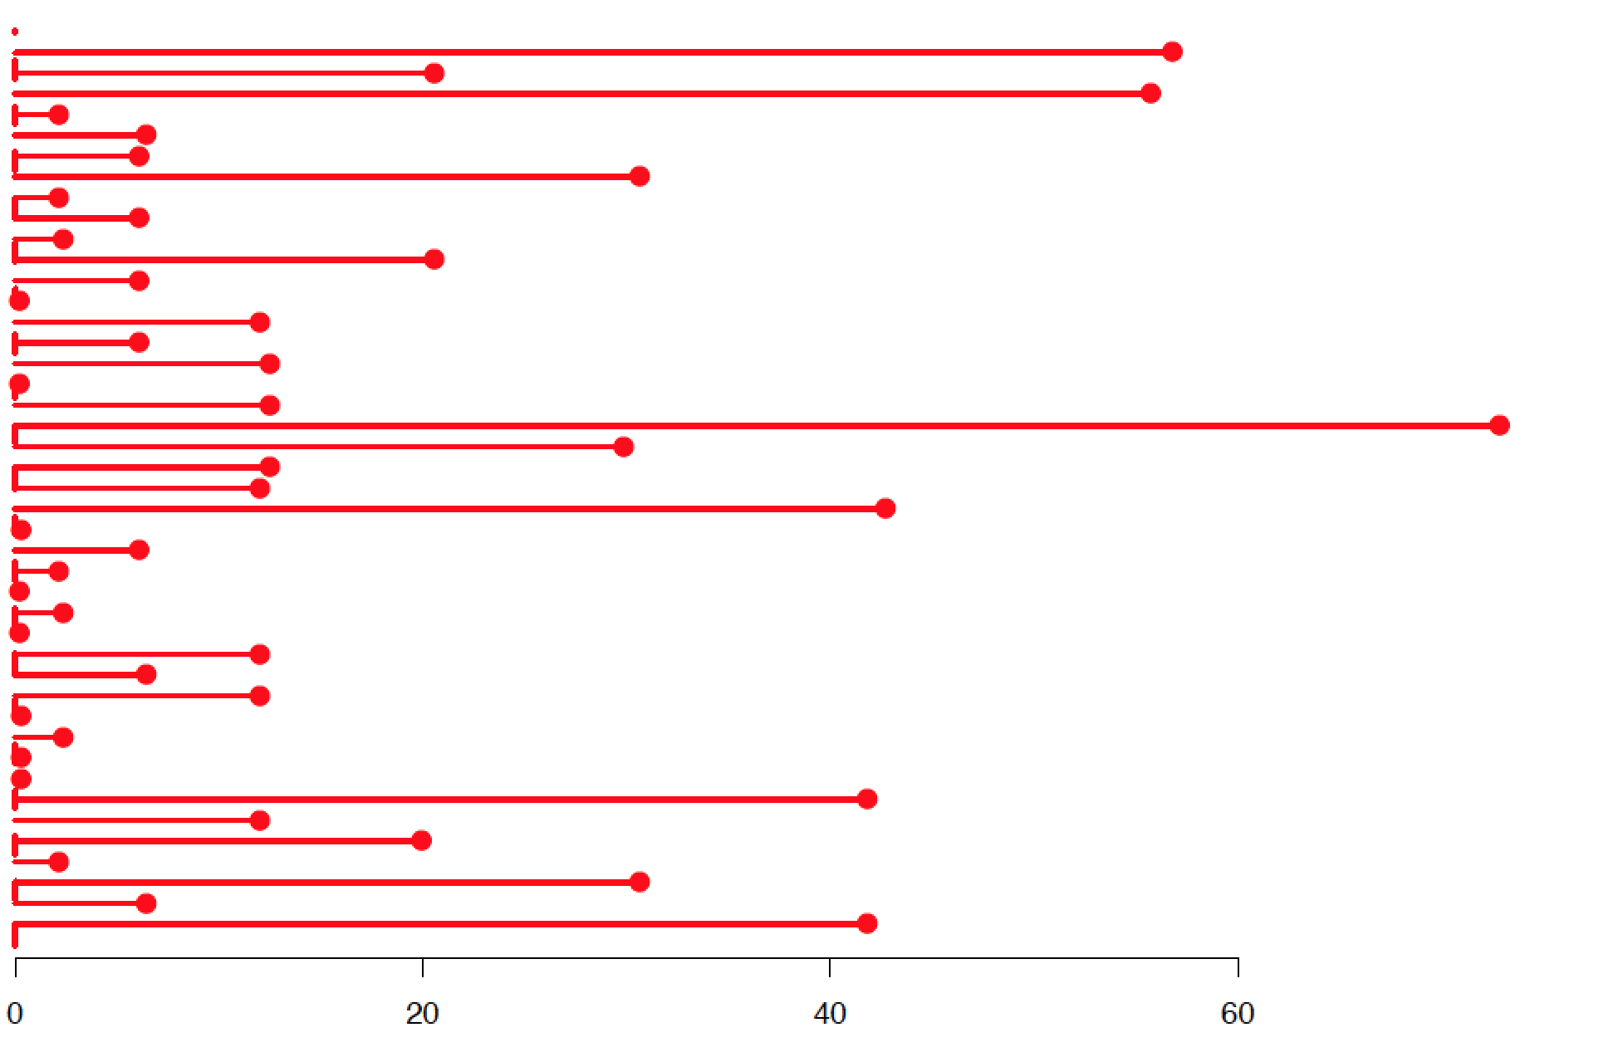
Summarising univariate data
Dispersion
Mean
Variance
Mean squared distance from mean
Height (Inches)

Slide 45
Summarising univariate data
Dispersion
Variance
var(x = ClassHeights)
16.96374
Mean squared distance from mean

Slide 46
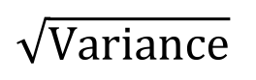
Summarising univariate data
Dispersion
Variance
var(x = ClassHeights)
16.96374
Mean squared distance from mean
Standard deviation
$$\sqrt{Variance}$$

Slide 47
Summarising univariate data
Dispersion
Variance
var(x = ClassHeights)
16.96374
Mean squared distance from mean
Standard deviation
sd(x = ClassHeights)
4.118707
$$\sqrt{Variance}$$

Slide 48
Summarising univariate data
Dispersion
Variance
var(x = ClassHeights)
16.96374
Mean squared distance from mean
Standard deviation
sd(x = ClassHeights)
4.118707
$$\sqrt{Variance}$$
Middle
68.2%
-1σ
1σ

Slide 49
Summarising univariate data
Dispersion
Variance
var(x = ClassHeights)
16.96374
Mean squared distance from mean
Standard deviation
sd(x = ClassHeights)
4.118707
$$\sqrt{Variance}$$
Middle
68.2%
68.02273 ± 4.118707
-1σ
1σ

Slide 50
Summarising univariate data
Dispersion
Variance
var(x = ClassHeights)
16.96374
Mean squared distance from mean
Standard deviation
sd(x = ClassHeights)
4.118707
$$\sqrt{Variance}$$
Middle
68.2%
68.02273 ± 4.118707
(Actual: 68.2%)
-1σ
1σ

Slide 51
Are class heights normally distributed?

Slide 52
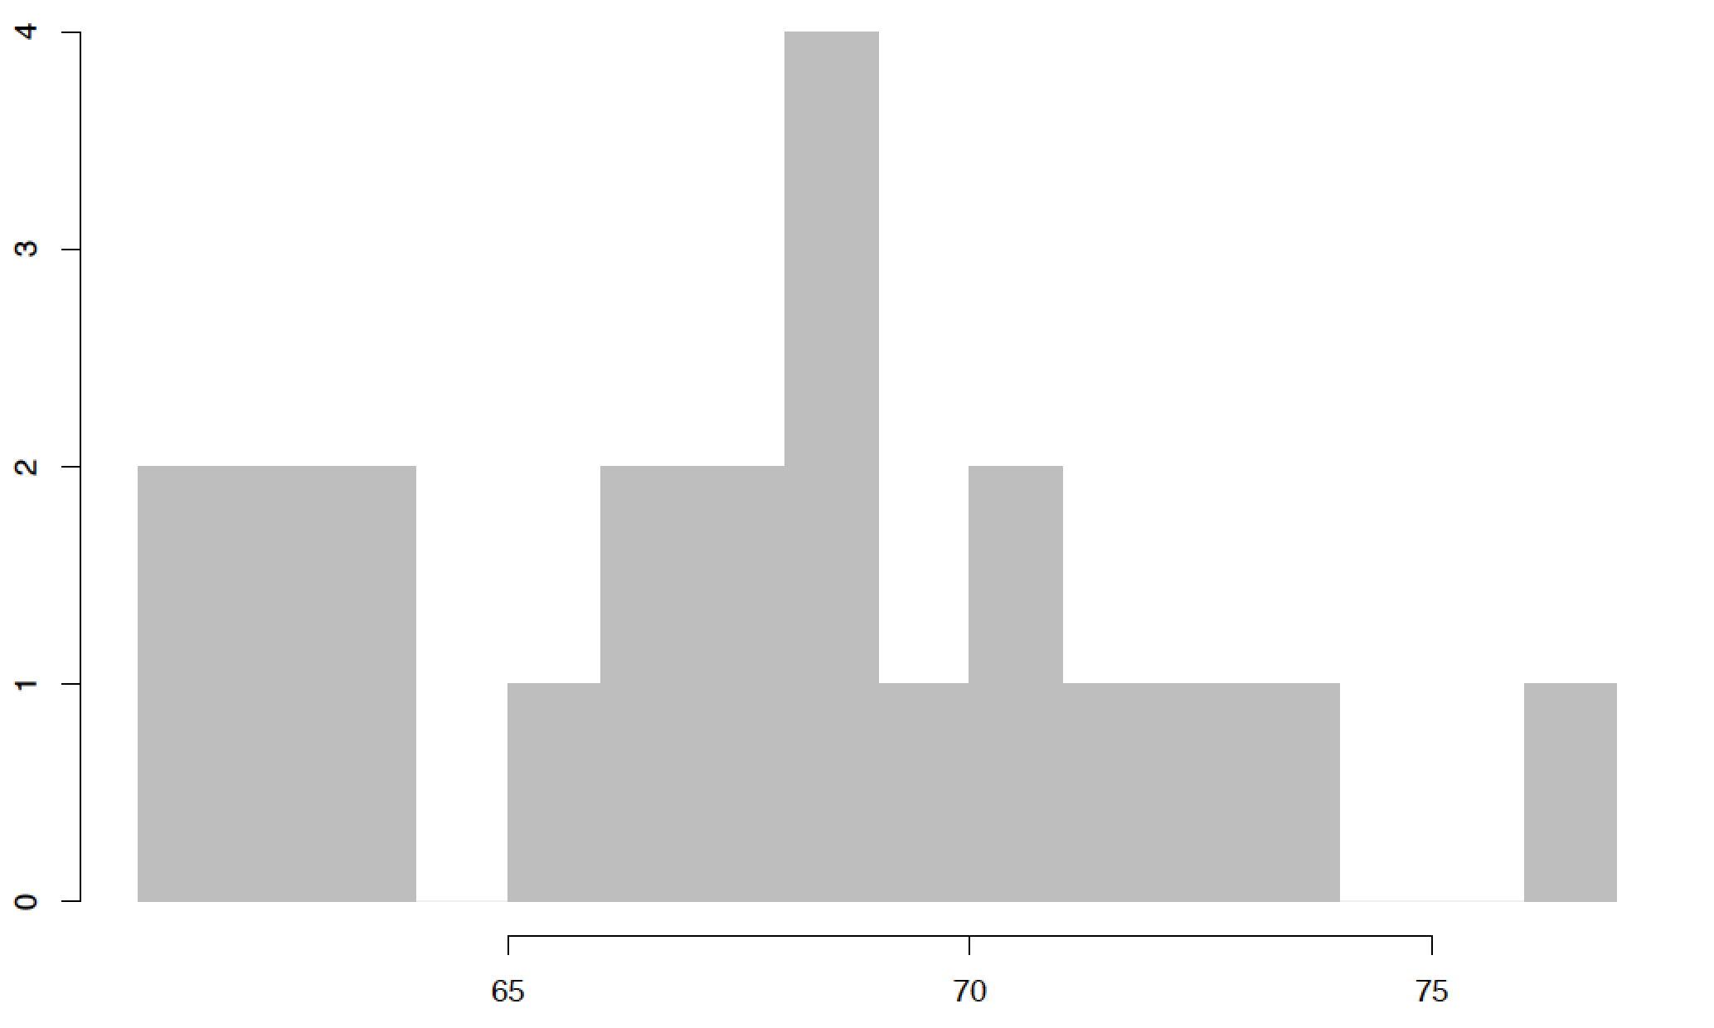
Are class heights normally distributed?
Frequency
Height (Inches)

Slide 53
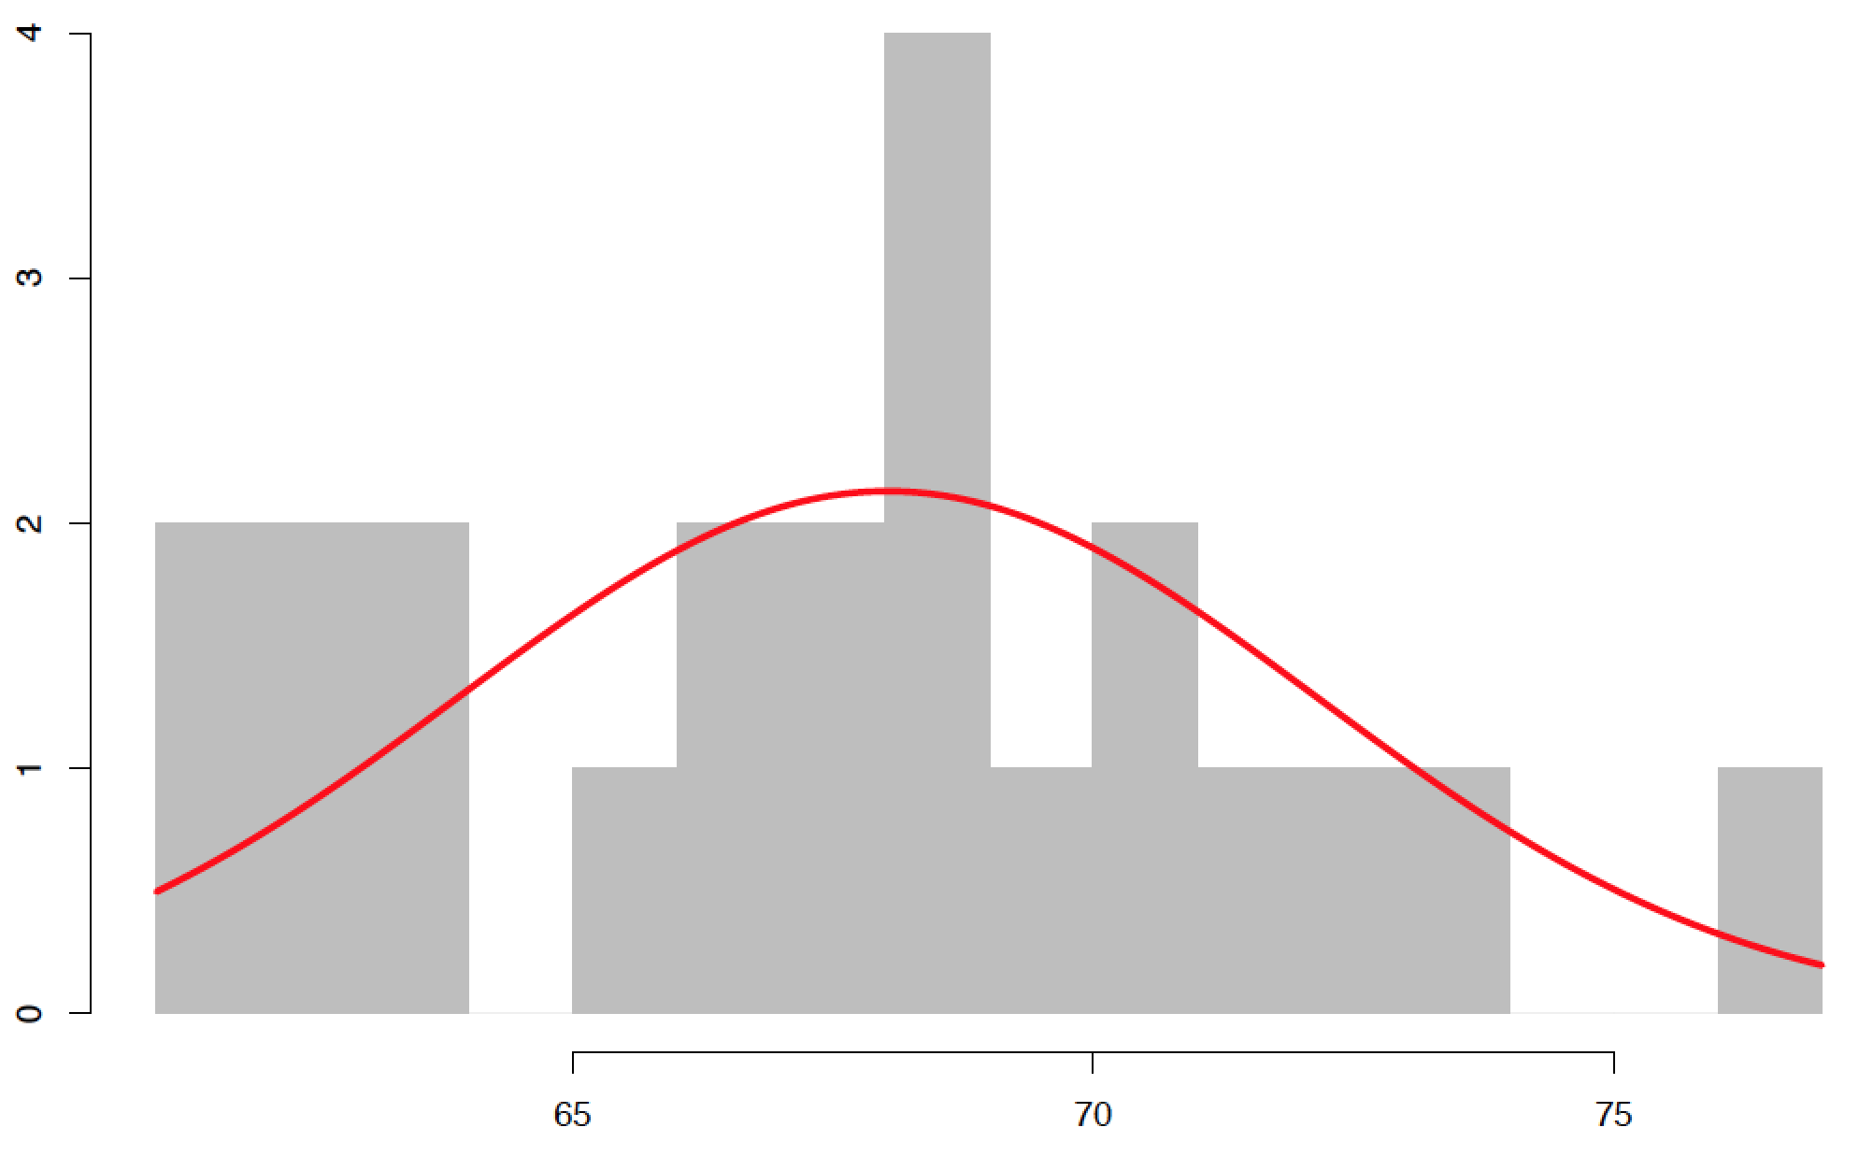
Are class heights normally distributed?
Frequency
Height (Inches)

Slide 54
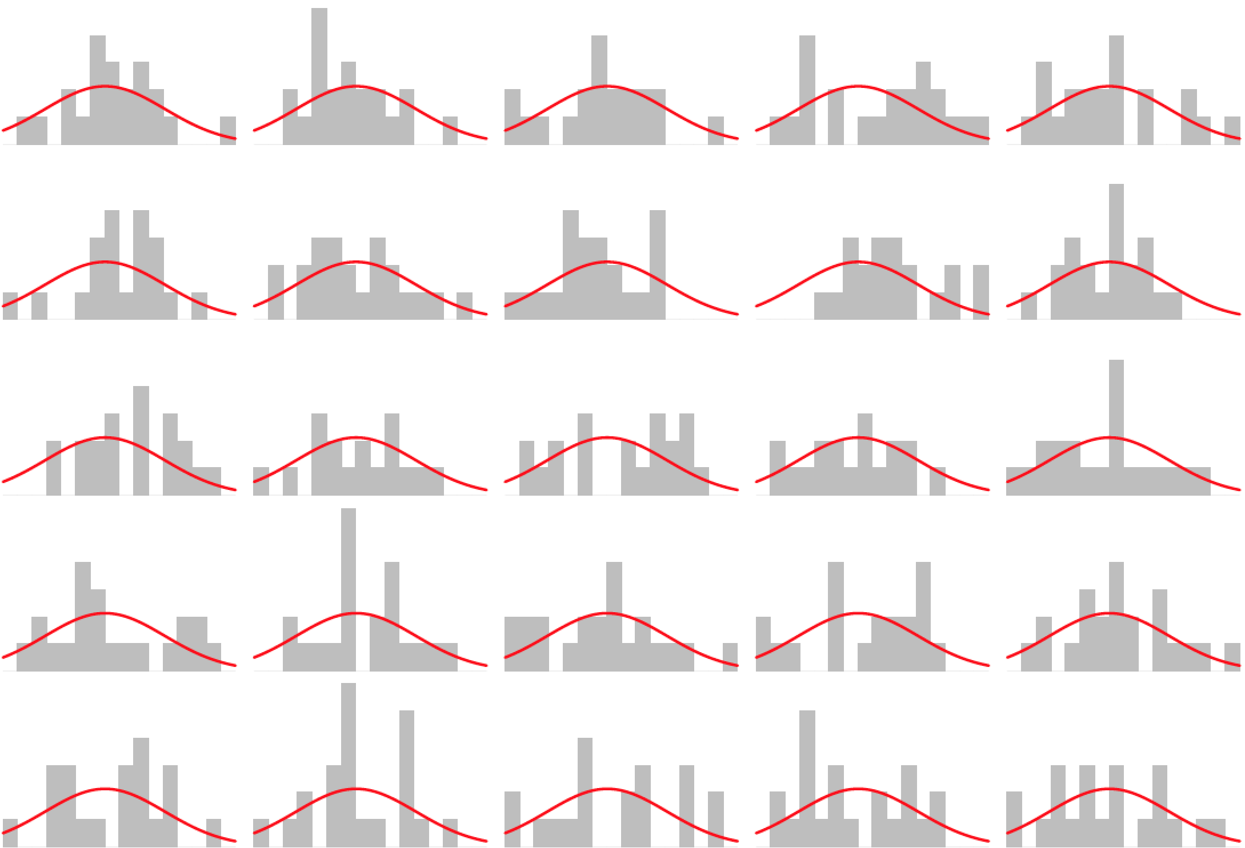
Are class heights normally distributed?

Slide 55
Are class heights normally distributed?
When sample size is small normally distributed data won’t always appear normal

Slide 56
Exercise
Notes:
Time to do an exericse

Slide 57
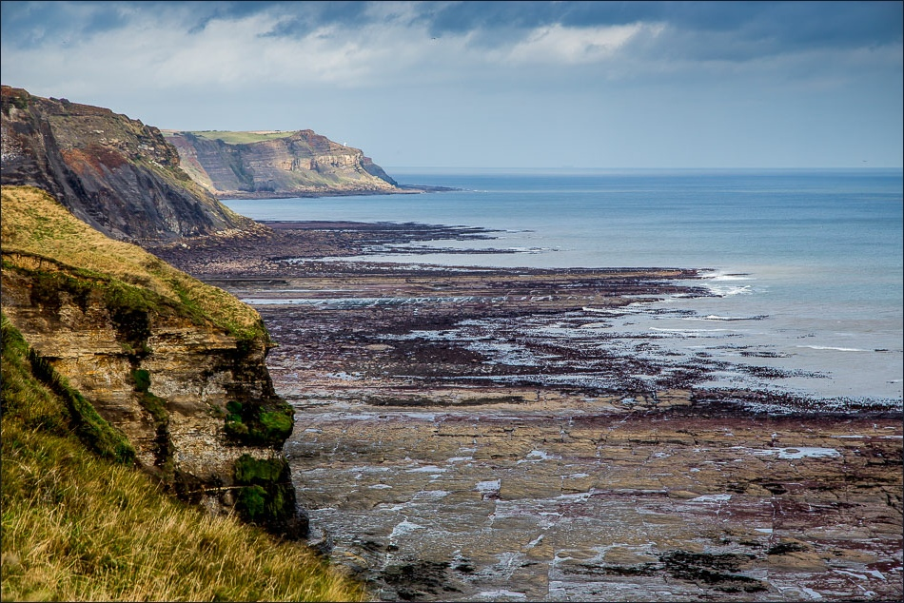
Exercise
Notes:
Imagine we are actually on a wave cut platform on the Yorkshire coast…

Slide 58
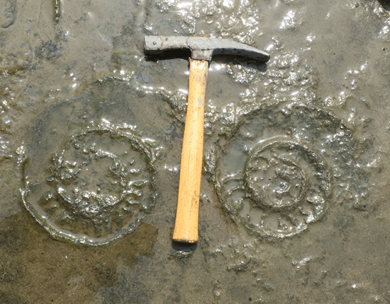
Exercise
Notes:
…when we look down we see the bedding plane beneath our feet is covered with ammonite fossils. We are going to use these as a data set to ask a variety of scientific questions

Slide 59

Exercise
Notes:
In life ammonites would look like living nautilus and are a close relative of squid and octopus, soft parts (eyes, tentacles) are not usually preserved however

Slide 60
Exercise
1
2
3
4
5
6
7
8
9
10
A
B
C
D
E
10m
F
G
H
I
J
10m
Notes:
Want to measure ammonites but there are many so tsk is split into 100 quadrants – one for each student (plus some leftover)

Slide 61
Exercise
1
2
3
4
5
6
7
8
9
10
A
B
C
D
E
10m
F
G
H
I
J
10m
Notes:
Note orientation and scale - essential elements of field diagrams in general

Slide 62
Exercise
1
1
2
3
4
5
6
7
8
9
10
2
3
4
A
B
6
5
C
8
9
7
D
10
E
11
10m
F
12
14
G
13
17
15
16
H
I
18
J
19
20
10m
Notes:
Note orientation and scale - essential elements of field diagrams in general

Slide 63
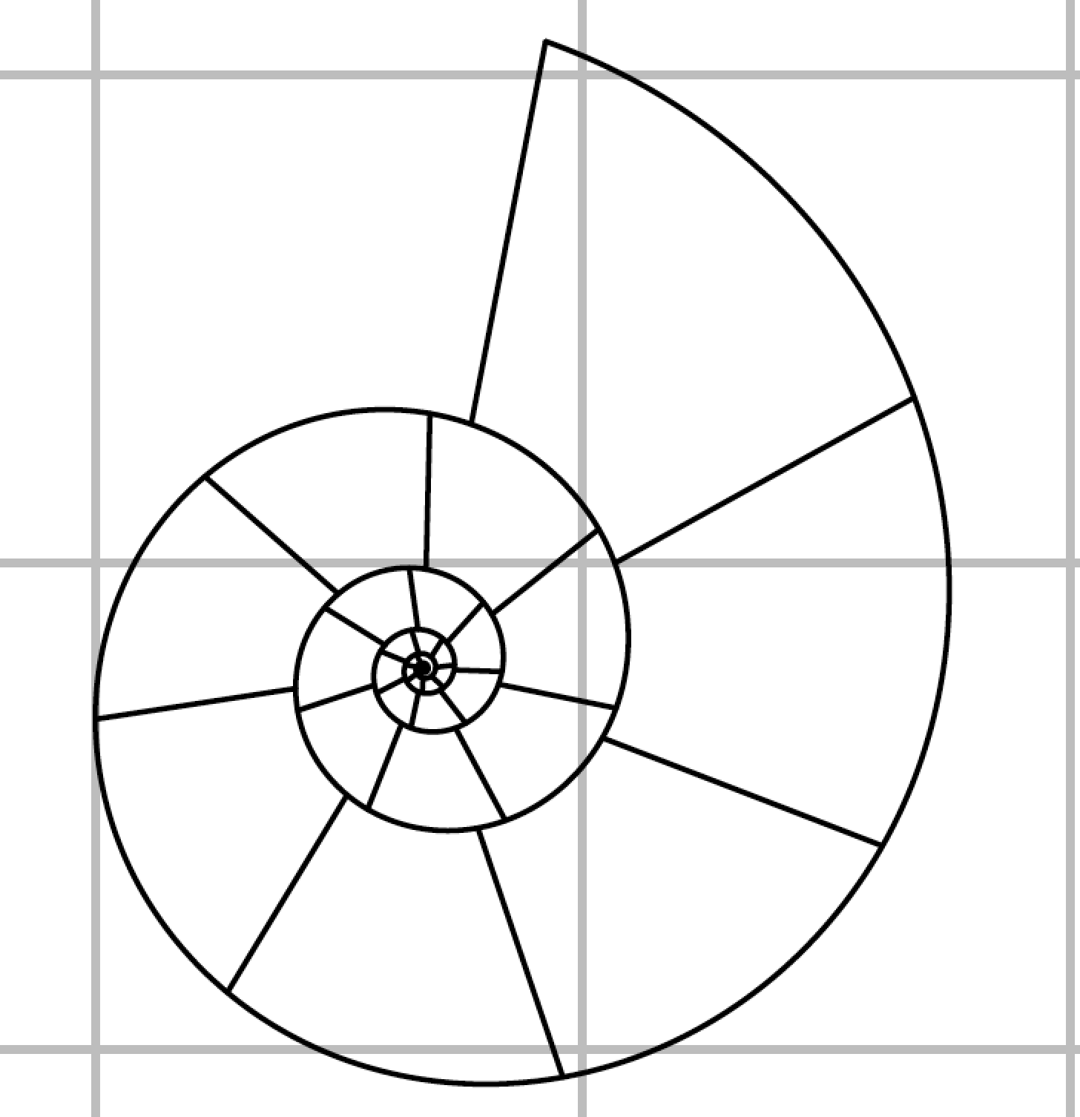
Exercise
1
1
2
3
4
5
6
7
8
9
10
2
3
4
A
B
6
5
C
8
9
7
D
10
E
11
10m
F
12
14
G
13
17
15
16
H
I
18
J
19
20
10m
Notes:
Note orientation and scale - essential elements of field diagrams in general

Slide 64
Exercise
1
1
2
3
4
5
6
7
8
9
10
2
3
4
A
B
6
5
C
8
9
7
D
10
E
11
10m
F
12
14
G
13
17
15
16
H
I
18
J
19
20
10m
Notes:
Note orientation and scale - essential elements of field diagrams in general

Slide 65
Exercise
Measure ammonites 4 and 17
Units of ruler are mm
Bin your data (for a histogram):
51-75 mm
76-100 mm
101-125 mm
126-150 mm
151-175 mm
176-200 mm
201-225 mm
226-250 mm
251-275 mm
1
2
3
4
5
6
7
1
2
3
8
9
10
4
A
B
6
C
5
9
10
D
8
7
E
11
10m
F
12
13
G
14
17
15
16
H
I
19
J
18
20
10m
Notes:
Note orientation and scale - essential elements of field diagrams in general

Slide 66
Exercise
[Histogram of class measurements in R]

Slide 67
Estimating the population mean

Slide 68
Estimating the population mean
Population
Current Leeds undergraduates

Slide 69
Estimating the population mean
Population
Sample
Current Leeds undergraduates
SOEE1475

Slide 70
Estimating the population mean
Population
Sample
Current Leeds undergraduates
SOEE1475
μ

Slide 71
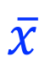
Estimating the population mean
Population
Sample
Current Leeds undergraduates
SOEE1475
μ
$$\overline{x}$$

Slide 72
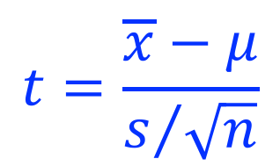
Estimating the population mean
Population
Sample
Current Leeds undergraduates
SOEE1475
μ
$$\overline{x}$$
$$t=\frac{\overline{x}−μ}{s/{\sqrt{n}}}$$

Slide 73
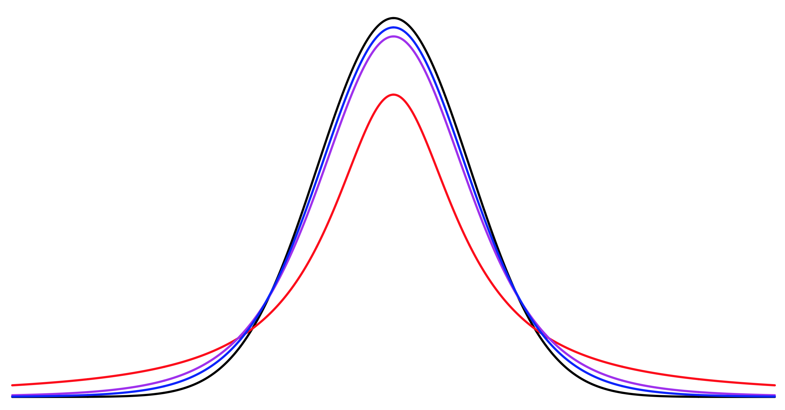
Estimating the population mean
t-distribution (n = 2)
Normal distribution
t-distribution (n = 6)
t-distribution (n = 11)

Slide 74
Estimating the population mean
One sample t-test

Slide 75
Estimating the population mean
One sample t-test
Probability a hypothesised population mean (mu) is correct
t.test(ClassHeights, mu = 72)$p.value
0.0001833178

Slide 76
Estimating the population mean
One sample t-test
Probability a hypothesised population mean (mu) is correct
t.test(ClassHeights, mu = 72)$p.value
0.0001833178
Range of values we can be N% confident population mean falls between
t.test(ClassHeights, conf.level = 0.99)$conf.int[1:2]
65.53648 70.50898

Slide 77
Comparing two samples

Slide 78
Comparing two samples

Slide 79
Comparing two samples

Slide 80
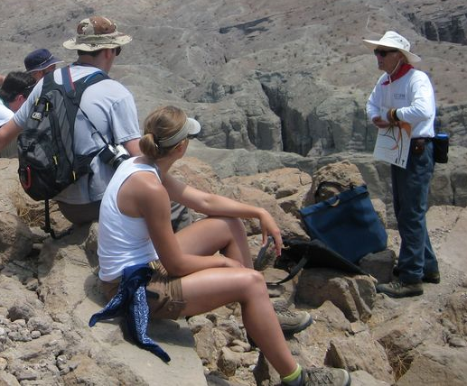
Comparing two samples

Slide 81
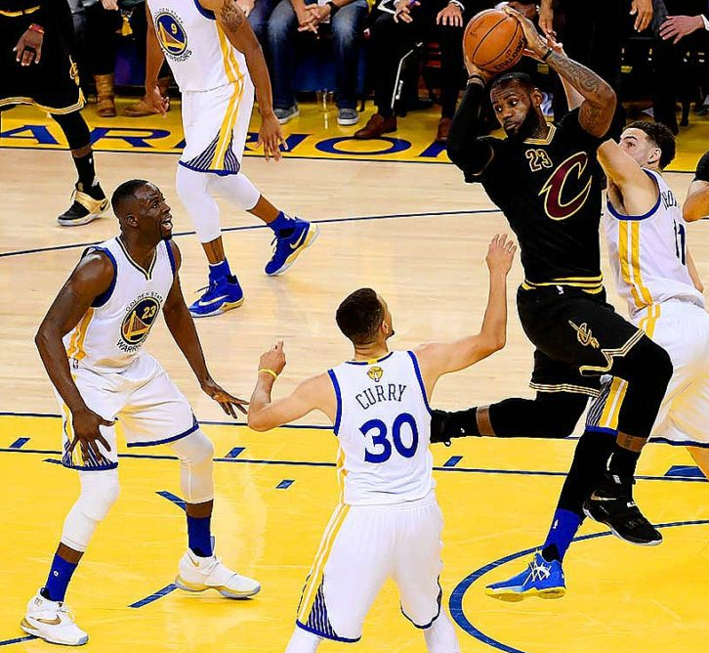
Comparing two samples

Slide 82
Comparing two samples
SOEE1475

Slide 83

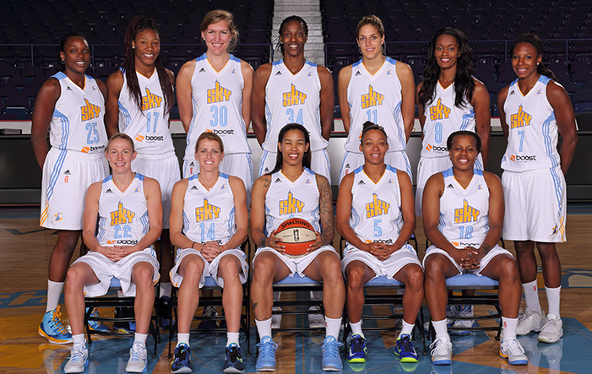
Comparing two samples
SOEE1475

Slide 84
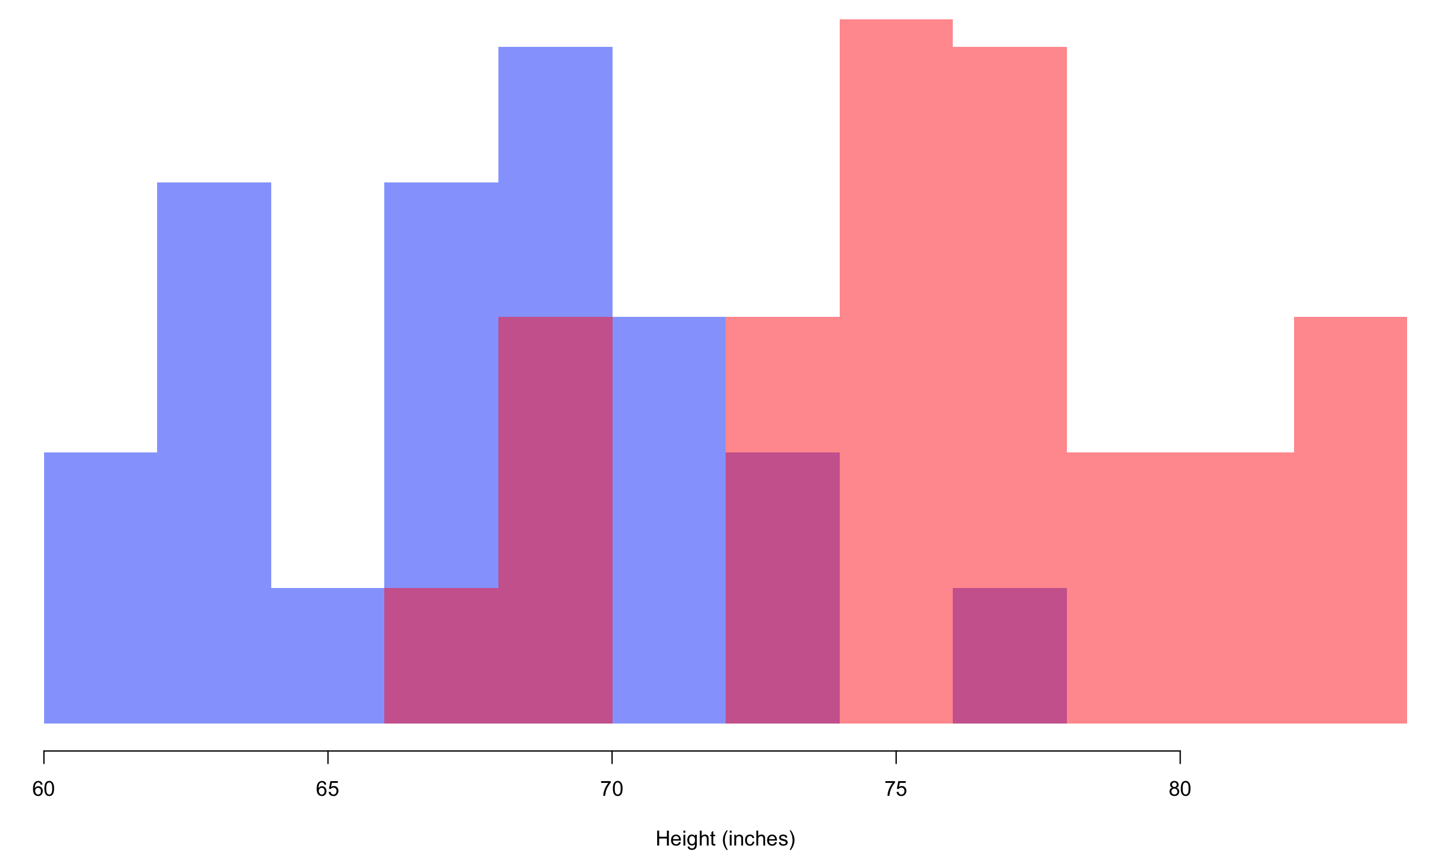
Comparing two samples
SOEE1475
Bulls + Sky

Slide 85
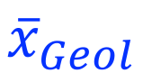
Comparing two samples
SOEE1475
$${\overline{x}}_{Geol}$$
Bulls + Sky

Slide 86
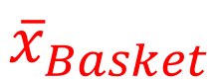
Comparing two samples
SOEE1475
$${\overline{x}}_{Geol}$$
$${\overline{x}}_{Basket}$$
Bulls + Sky

Slide 87
Comparing two samples
Two sample t-test
Probability two samples are drawn from populations with same mean (mu)

Slide 88
Comparing two samples
Two sample t-test
Probability two samples are drawn from populations with same mean (mu)
t.test(x = GeolHeights, y = BasketHeights)$p.value
7.314495e-09

Slide 89
Lesson #2: data quality
SOEE1475
Chicago
Bulls + Sky

Slide 90
Precision vs accuracy
All measurements are wrong (for a specified level of wrongness)
The use of any measuring tool/technique must be accompanied by an awareness of precision and accuracy
a measurement is precise if repeated measurements are similar
a measurement is accurate if it is close to the true value
All combinations of high/low precision and high/low accuracy are possible

Slide 91
How (most) science works
Question
Data
Analysis

Slide 92
Location parameters: the mean
Typical of the population = value every individual would have if they were all the same
Simple and easy to interpret, but only when the population is symmetrical!
Arithmetic mean or average
(or expectation)
arithmetic mean
arithmetic mean
symmetric
asymmetric
Geometric mean
Often used for asymmetric (skewed) populations when the arithmetic mean is not typical (e.g., trace element concentrations)

Slide 93
Statistical notation
By convention
Values of the variable in a population are denoted by upper-case Roman letters (e.g., X, Y etc.)
Values for the N individuals in a population are signified by letters with subscripts (e.g., X₁, X₂,……..X_{N})
Population parameters are symbolised by Greek letters (e.g., μ, σ etc.)
Sample parameters are symbolised by lower-case Roman letters (e.g., a, b, s etc.)

Slide 94
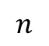
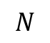
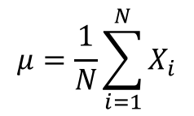
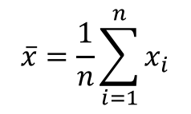
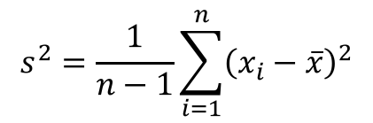
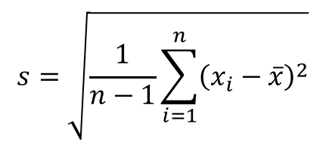
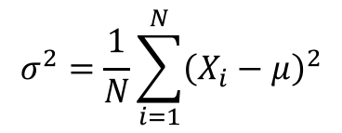
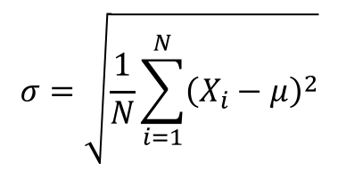
Statistical notation: why is this important?
Because it tells you if you are dealing with a population or a sample, for which the equations may be different
Sample
Population
number of individuals
$$n$$
$$N$$
values of variable
therefore u.c. Roman
sample parameter
therefore l.c. Roman
population parameter
therefore Greek
$$\overline{x}=\frac{1}{n}\sum_{i=1}^{n}{x_{i}}$$
$$μ=\frac{1}{N}\sum_{i=1}^{N}{X_{i}}$$
arithmetic mean
$$s^{2}=\frac{1}{n−1}\sum_{i=1}^{n}{{\left(x_{i}−\overline{x}\right)}^{2}}$$
$$σ^{2}=\frac{1}{N}\sum_{i=1}^{N}{{\left(X_{i}−μ\right)}^{2}}$$
variance
Bessel’s correction
$$s=\sqrt{\frac{1}{n−1}\sum_{i=1}^{n}{{\left(x_{i}−\overline{x}\right)}^{2}}}$$
$$σ=\sqrt{\frac{1}{N}\sum_{i=1}^{N}{{\left(X_{i}−μ\right)}^{2}}}$$
standard deviation

Slide 95
Location parameters: mode and median
arithmetic mean
mode
arithmetic mean
mode
median
median
symmetric
asymmetric
mode
most frequently occurring value
median
middle value in data set of ascending order; often used as mean in asymmetrical populations
= 50th percentile

Slide 96
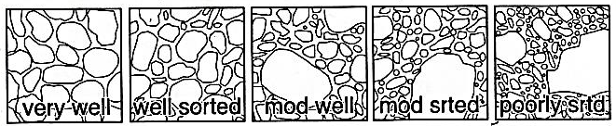
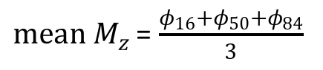
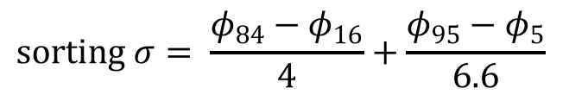
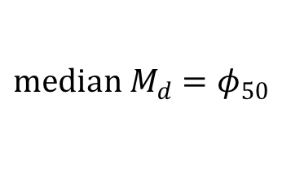
Measures of dispersion I
Very important in geology
Grain-size variability (Folk parameters) as an indicator of depositional processes
$$median M_{d}=φ_{50}$$
$mean M_{z}$ = $\frac{φ_{16}+φ_{50}+φ_{84}}{3}$
$$sorting σ= \frac{φ_{84}−φ_{16}}{4}+\frac{φ_{95}−φ_{5}}{6.6}$$
<0.35
0.35 - 0.50
0.50 - 0.70
0.70 - 1.00
1.00 – 2.00
φ₅
φ₅₀
φ₁₆
φ₉₅
φ₈₄

Slide 97
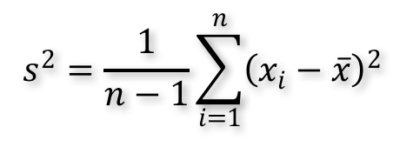
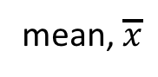
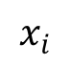
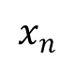
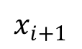
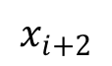
Measures of dispersion II: sample variance
$$s^{2}=\frac{1}{n−1}\sum_{i=1}^{n}{{\left(x_{i}−\overline{x}\right)}^{2}}$$
a measure of the scatter (dispersion) of values about the mean
Sample variance
mean, $\overline{x}$
$$x_{i}$$
$$x_{i+1}$$
$$x_{i+2}$$
$$x_{n}$$
n = 8

Slide 98
Measures of dispersion III: standard deviation
standard deviation (population) σ (sample) s
Square root of the variance and often easier to interpret (i.e. same units as data)
~68% of all values falls within ±1σ of mean
~95% of all values lie within ±2σ
Remember the Bessel correction: (n-1 for samples, N for populations)
68%
95%
-3σ
-2σ
-1σ
0σ
1σ
2σ
3σ

Slide 99
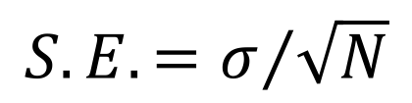
Measures of dispersion IV: sample error
population standard error
$$S.E.=σ/{\sqrt{N}}$$
If a large number of samples are collected, their individual (i.e. sample) means form a symmetrical (i.e. normal) distribution (see later) centred on the population mean
The values of the individual sample means have a standard deviation known as the standard error
We’ll explore this more next week, but you will need the equation for MCQ2

Slide 100
Measures of shape
long-tail of
high values
long-tail of
low values
Skew:
positively (or right) skewed
mean > median
Negatively (or left) skewed
mean < median
Kurtosis:
leptokurtic = attenuated mode
platykurtic = plateau mode

